Slide 1
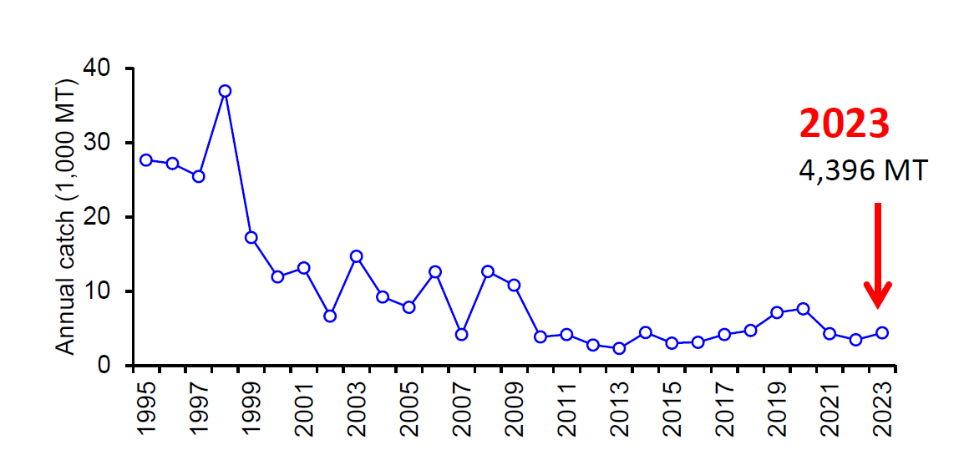
Total annual catch
NPFC-2025-SSC NFS02-WP01 Rev.2
A figure for a time series of total catch
Summary

Slide 2
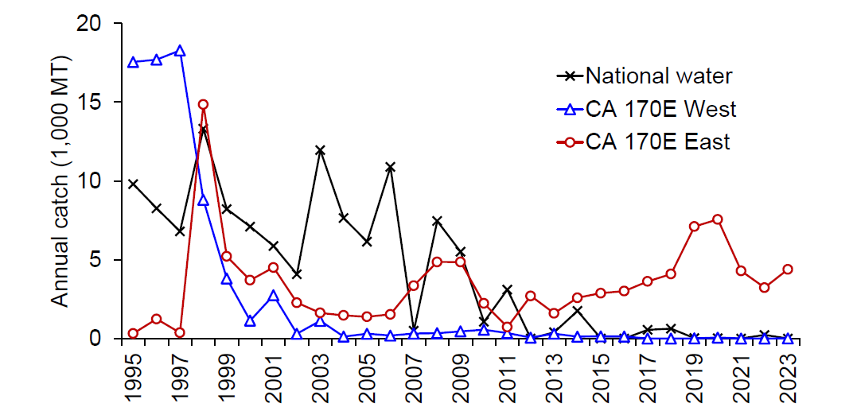
Annual catch by area/cohort
A figure for a time series of catch by area/cohort
Summary

Slide 3
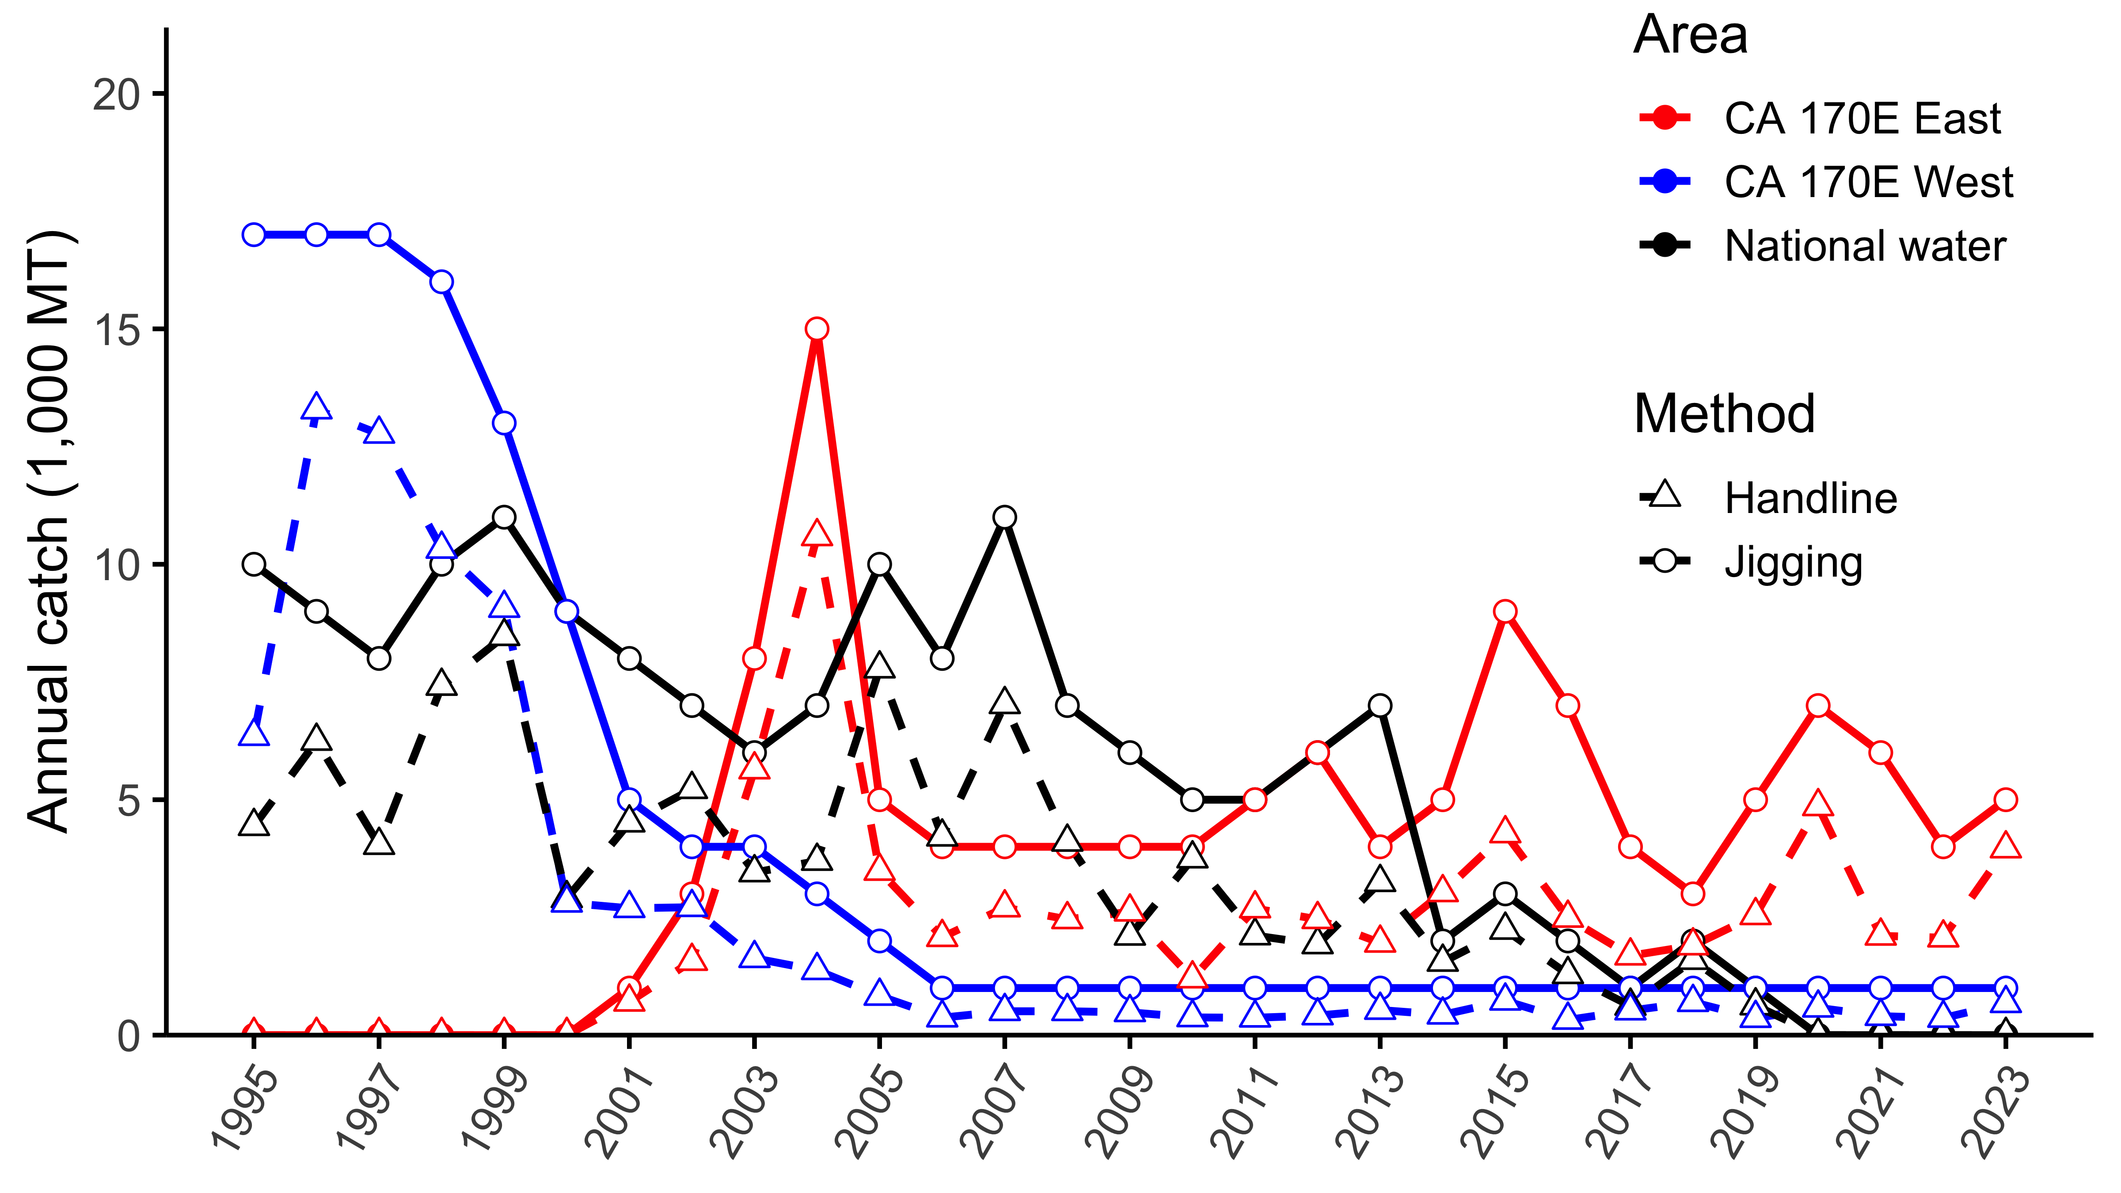
Annual catch by cohort and fishing technique
A figure for a time series of catch by area/cohort and fishing technique (machine jigging or handline, if data available)

Slide 4
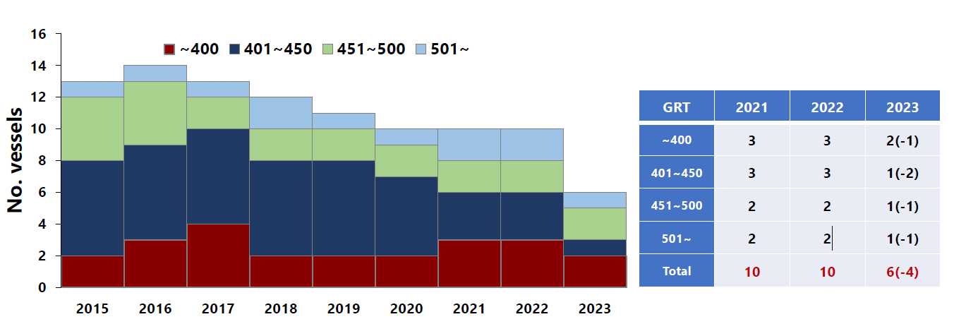
Total number of vessels
A figure for a time series of total number of vessels, good to see vessel details, ok if not available
One hundred and twenty-seven fishing vessels are operating
Nine vessels decreased compared to last year
Summary

Slide 5
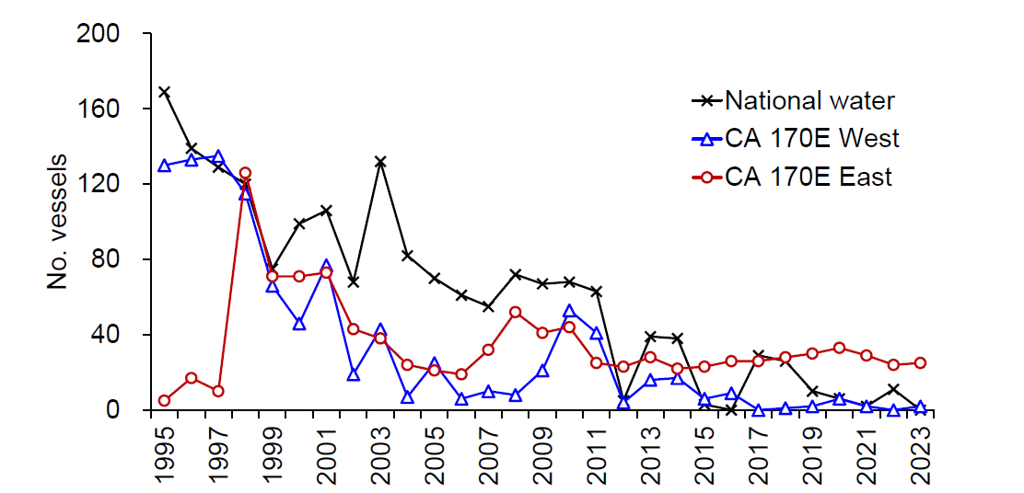
Number of vessels by area
A figure for a time series of number of vessels by area
One hundred and twenty-seven fishing vessels are operating
Nine vessels decreased compared to last year
Summary

Slide 6
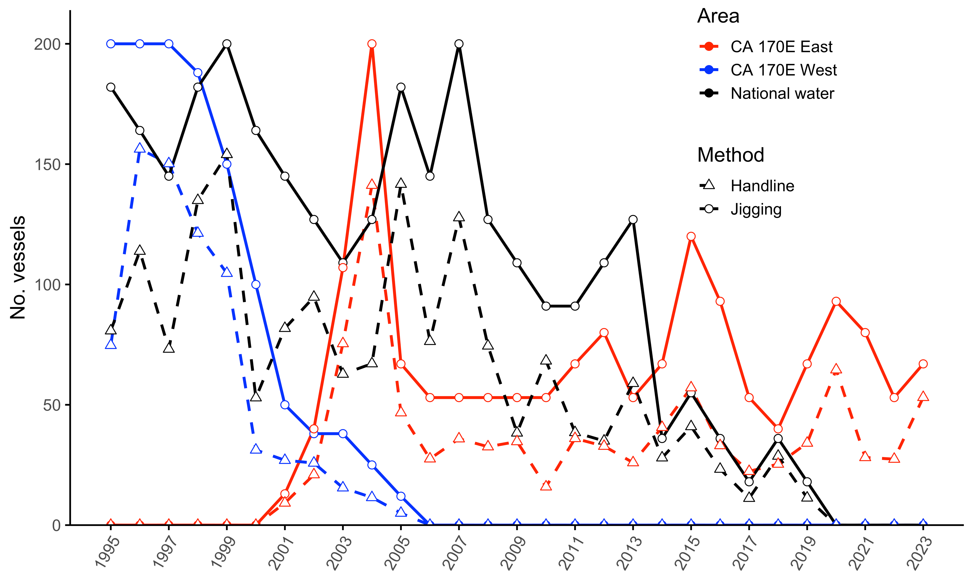
Number of vessels by area and fishing technique
or number of fishing machines or fishing lines by area
A figure for a time series of number of vessels by area and fishing technique (machine jigging or handline, if data available)
One hundred and twenty-seven fishing vessels are operating
Nine vessels decreased compared to last year
Summary

Slide 7
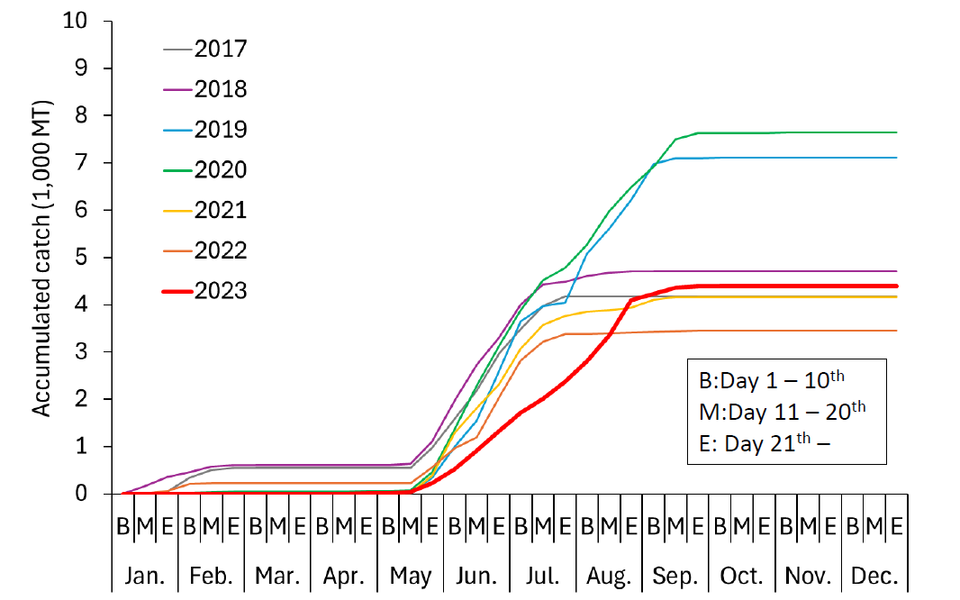
Accumulated catch by cohort
Figures for accumulated catch for last several years by cohort
Summary
This was the lowest since 1958

Slide 8
Monthly/seasonal catch by cohort
B:Day 1 – 10th
M:Day 11 – 20th
E: Day 21th –
Figures for monthly catch for last several years by cohort
Summary
This was the lowest since 1958

Slide 9
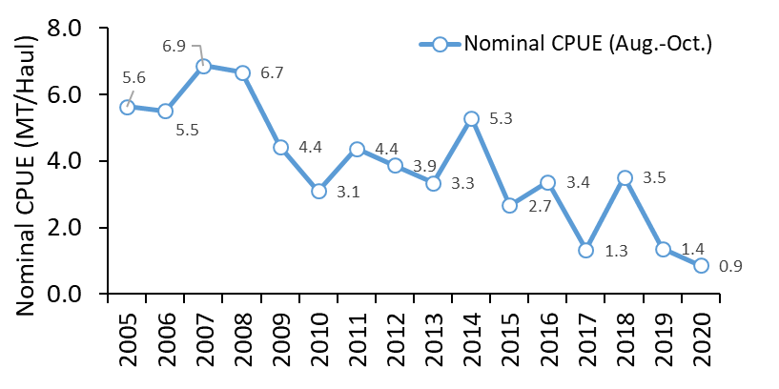
Nominal CPUE by cohort
Figures for nominal CPUE by cohort (monthly CPUE is preferred; use slide #9 if fishing technique information is available)
Nominal CPUE was 0.9 and lowest since 2005.
Summary

Slide 10
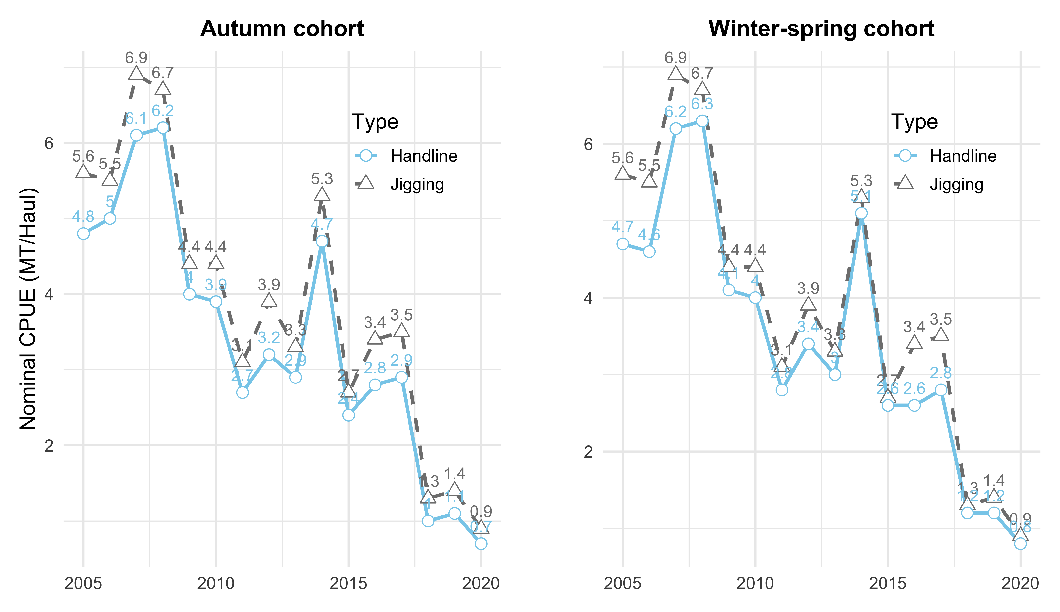
Nominal CPUE by cohort and fishing technique
Figures for nominal CPUE by cohort and fishing technique (machine jigging or handline, if data available; monthly CPUE is preferred)
Nominal CPUE was 0.9 and lowest since 2005.
Summary

Slide 11
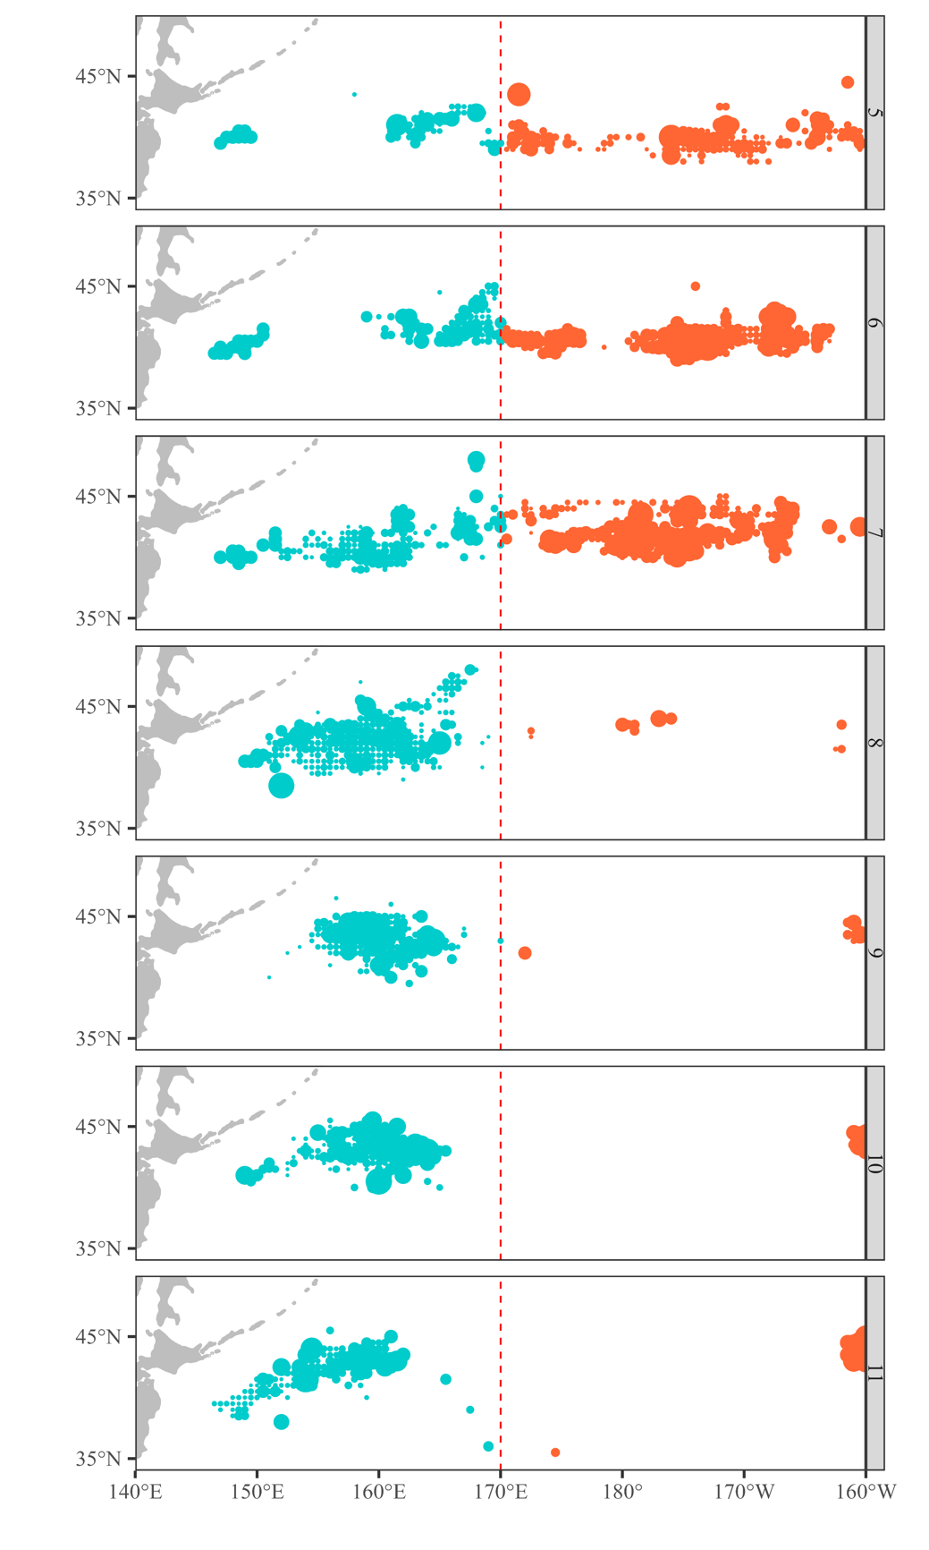
Spatial nominal CPUE
Figures for spatial nominal CPUE by cohort for last year

Slide 12
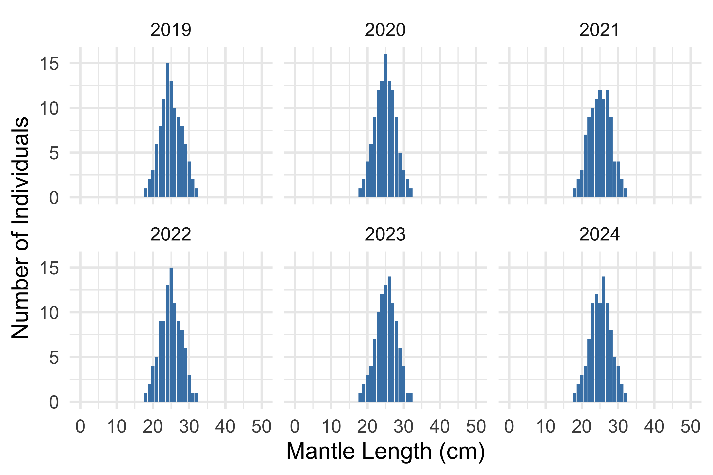
Size composition in catch by year
Sample figure
Note: Specify mantle length, total length or fork length

Slide 13
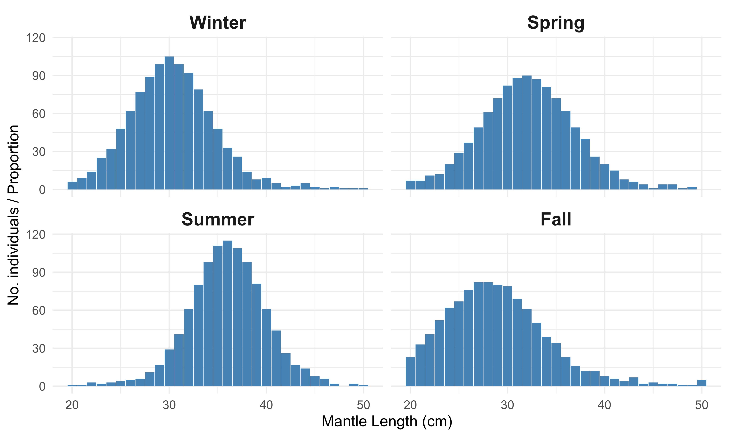
Size composition in catch by season
Ok if not available
Sample figure
Note: Specify mantle length, total length or fork length

Slide 14
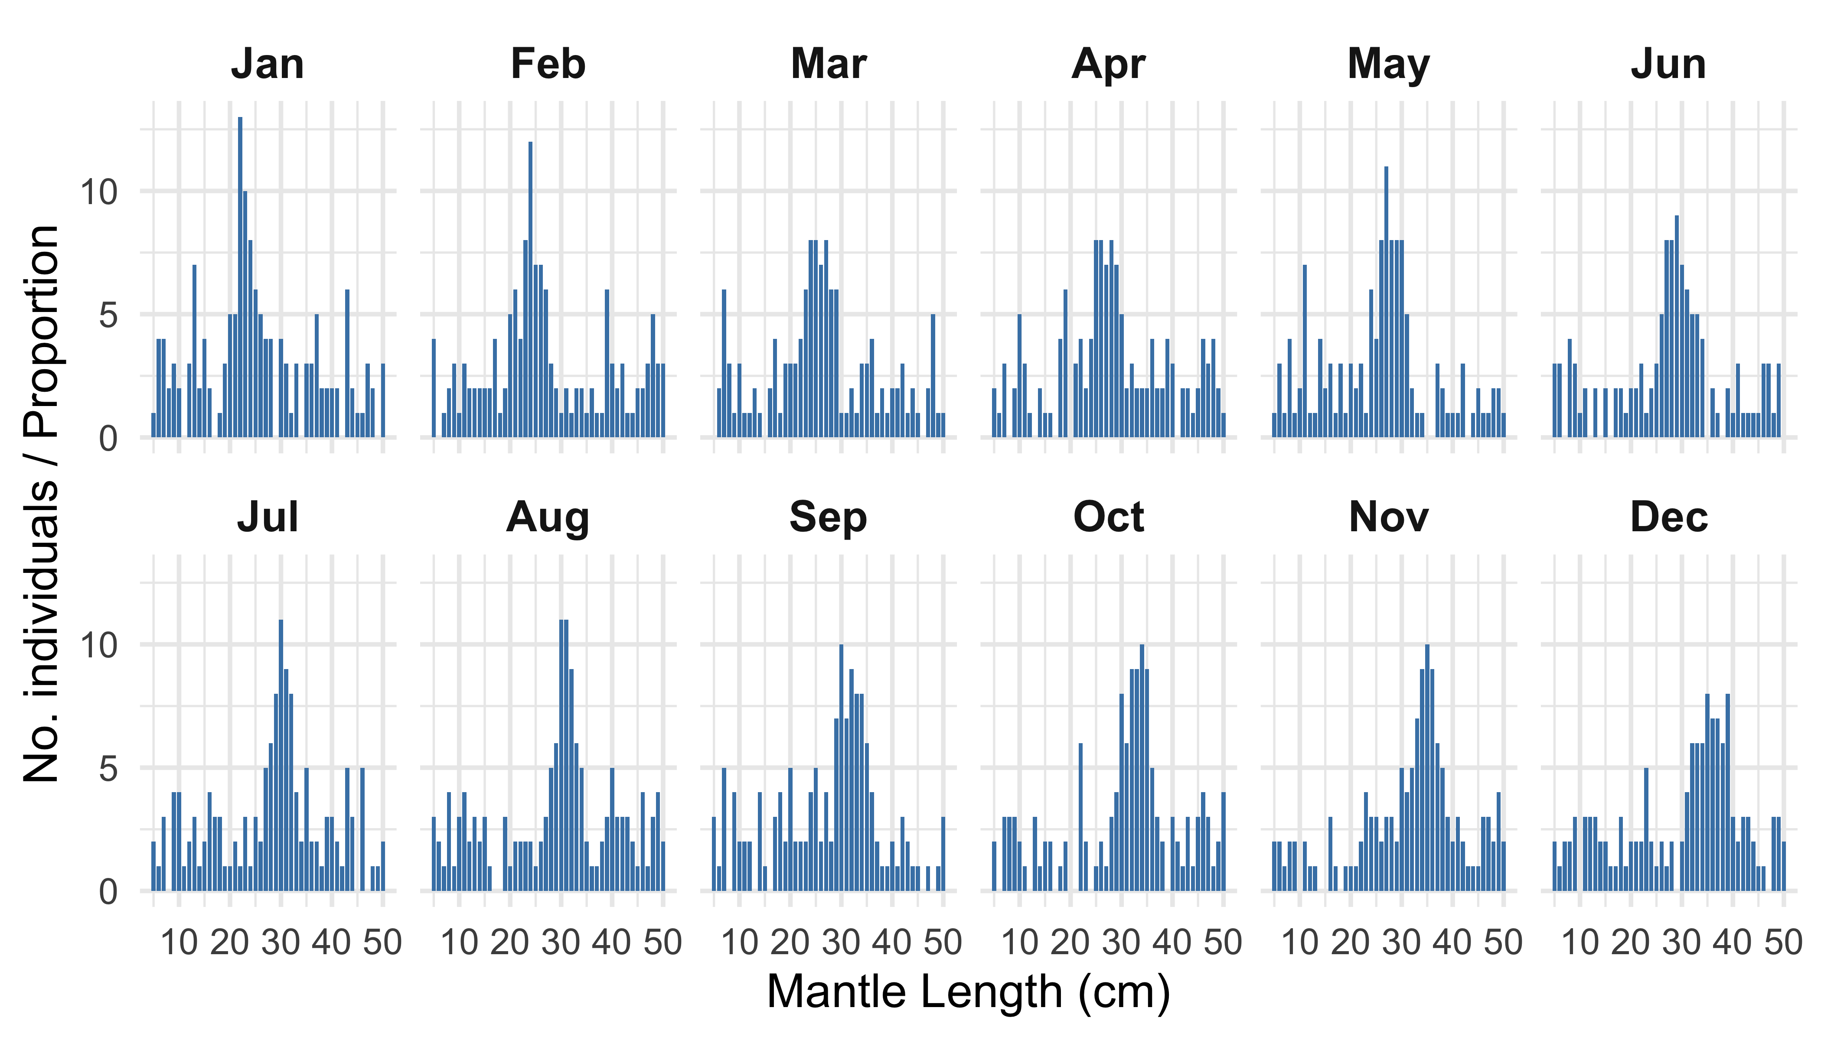
Size composition in catch by month
Ok if not available
Sample figure
Note: Specify mantle length, total length or fork length

Slide 15
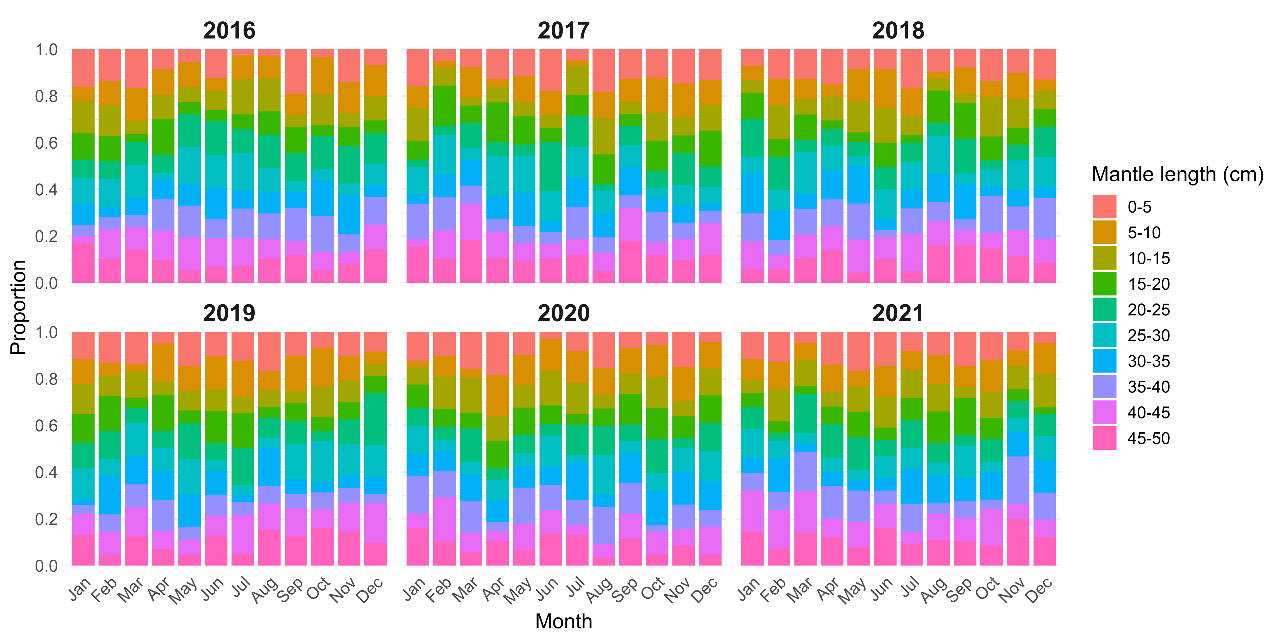
Size composition in catch by year-month
By year-season if monthly data are not available; ok if both not available
Sample figure
Note: Specify mantle length, total length or fork length

Slide 16
170E West, size composition in catch by year
Sample figure
Note: Specify mantle length, total length or fork length

Slide 17
170E West, size composition in catch by season
Ok if not available
Sample figure
Note: Specify mantle length, total length or fork length

Slide 18
170E West, size composition in catch by month
Ok if not available
Sample figure
Note: Specify mantle length, total length or fork length

Slide 19
170E West, size composition in catch by year-month
By year-season if monthly data are not available; ok if both not available
Sample figure
Note: Specify mantle length, total length or fork length

Slide 20
170E East, size composition in catch by year
Sample figure
Note: Specify mantle length, total length or fork length

Slide 21
170E East, size composition in catch by season
Ok if not available
Sample figure
Note: Specify mantle length, total length or fork length

Slide 22
170E East, size composition in catch by month
Ok if not available
Sample figure
Note: Specify mantle length, total length or fork length

Slide 23
170E East, size composition in catch by year-month
By year-season if monthly data are not available; ok if both not available
Sample figure
Note: Specify mantle length, total length or fork length

Slide 24
Description of methods for obtaining size composition
Description of the sampling protocol (e.g., frequency, location, and sampling design)
How and where lengths were measured (on board or in the lab)
The type of length measured (e.g., total length, fork length, mantle length), including measurement standards (e.g., the measuring instrument used, the precision of the measurement, and the procedures for handling the specimens during measurement)
The number of samples or individuals measured
Procedures for data recording and quality control
Methods for processing and grouping the size data
Any potential biases or limitations associated with the sampling and measurement methods

